Slide 1
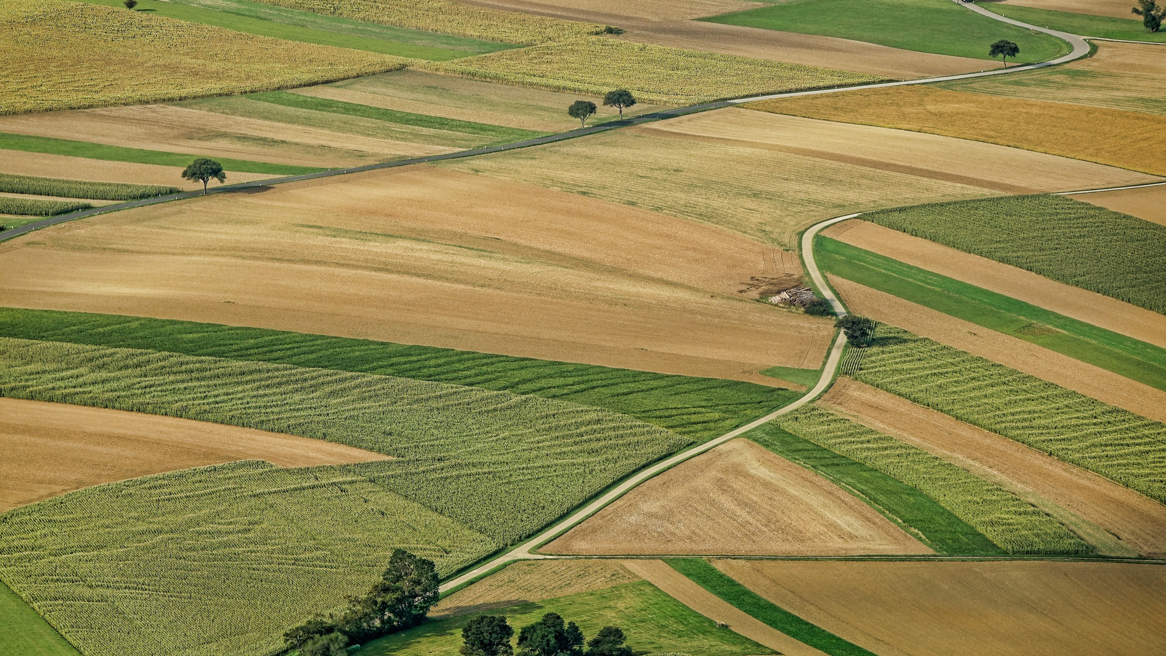
The Impact of Climate Change on Crop Production in the USA
Presented by:
Alesia J Magdaleno Coblentz David Ngethe
Jessica Ugolik Laverne Eubanks Skyrie Louissaint Tami Bongolan
Date:
April 10th, 2022

Slide 2
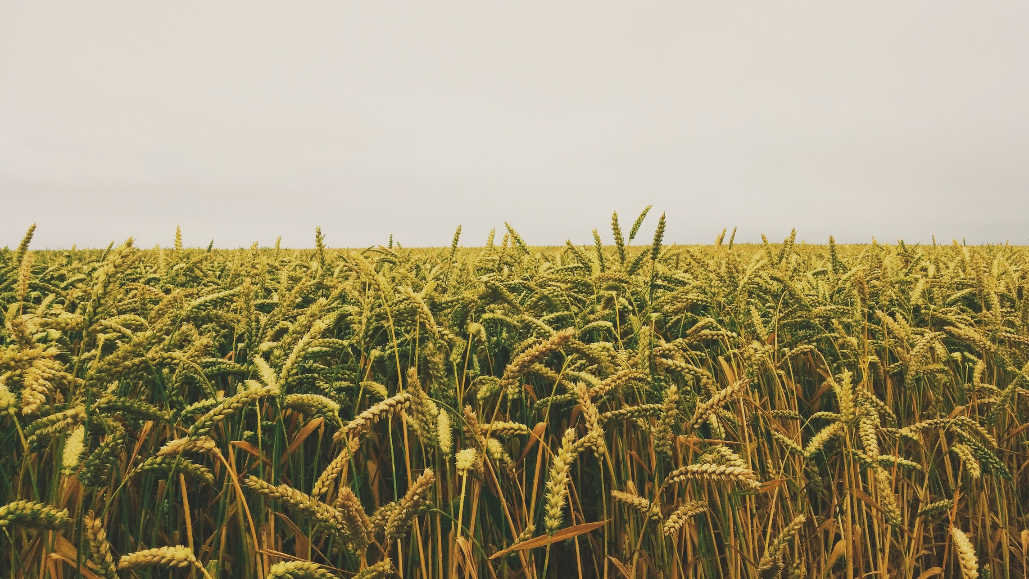
Team
Introductions

Slide 3

Alesia J Magdaleno Coblentz
Currently lives in Indiana with her very amazing, supportive wife.
Mother of 2 daughters and a son, and Grandmother of 2 amazing grandsons.
Has worked 15+ years in the quick service food and retail industry.
Currently only enrolled in WozU and making the big change from the retail industry to Data Science because that is where the future is leading and wants her children and grandchildren to know you're never to old to make a change.

Slide 4

David Ngethe
Married with 2 Kids
Currently employed at Motorola Solutions as a System Technologist
Education background as a Microsoft Certified Systems Engineer
12 years’ Experience in Desktop and Helpdesk Support
Interested in Data Science program as a need for Change.

Slide 5

Jessica Ugolik
Earned B.S. in Behavioral Psychology in 2004
10 years as an ABA Therapist
Last 10 years in the service industry and traveling
Joined the data science program to give love for statistics a direction in the workforce

Slide 6

Laverne Eubanks
Boy Mom
Weston - Age 7 Edward – Age 6
Senior at Park University in Kansas City, MO - majoring in Data Management and due to graduate with Bachelor’s December 2023
Currently employed as a Research Intern at NAIC

Slide 7

Skyrie Louissaint
Mother of a son Aizen - Age 4
Bachelors of Arts in Applied Mathematics 2017 Currently a mathematics teacher since 2018

Slide 8

Tami Bongolan
Former Research and Development Technician at Intel who is looking forward to using data science skills.
Degree in Visual Communication
Currently a new/used bookstore owner at Fischermen Books.

Slide 9
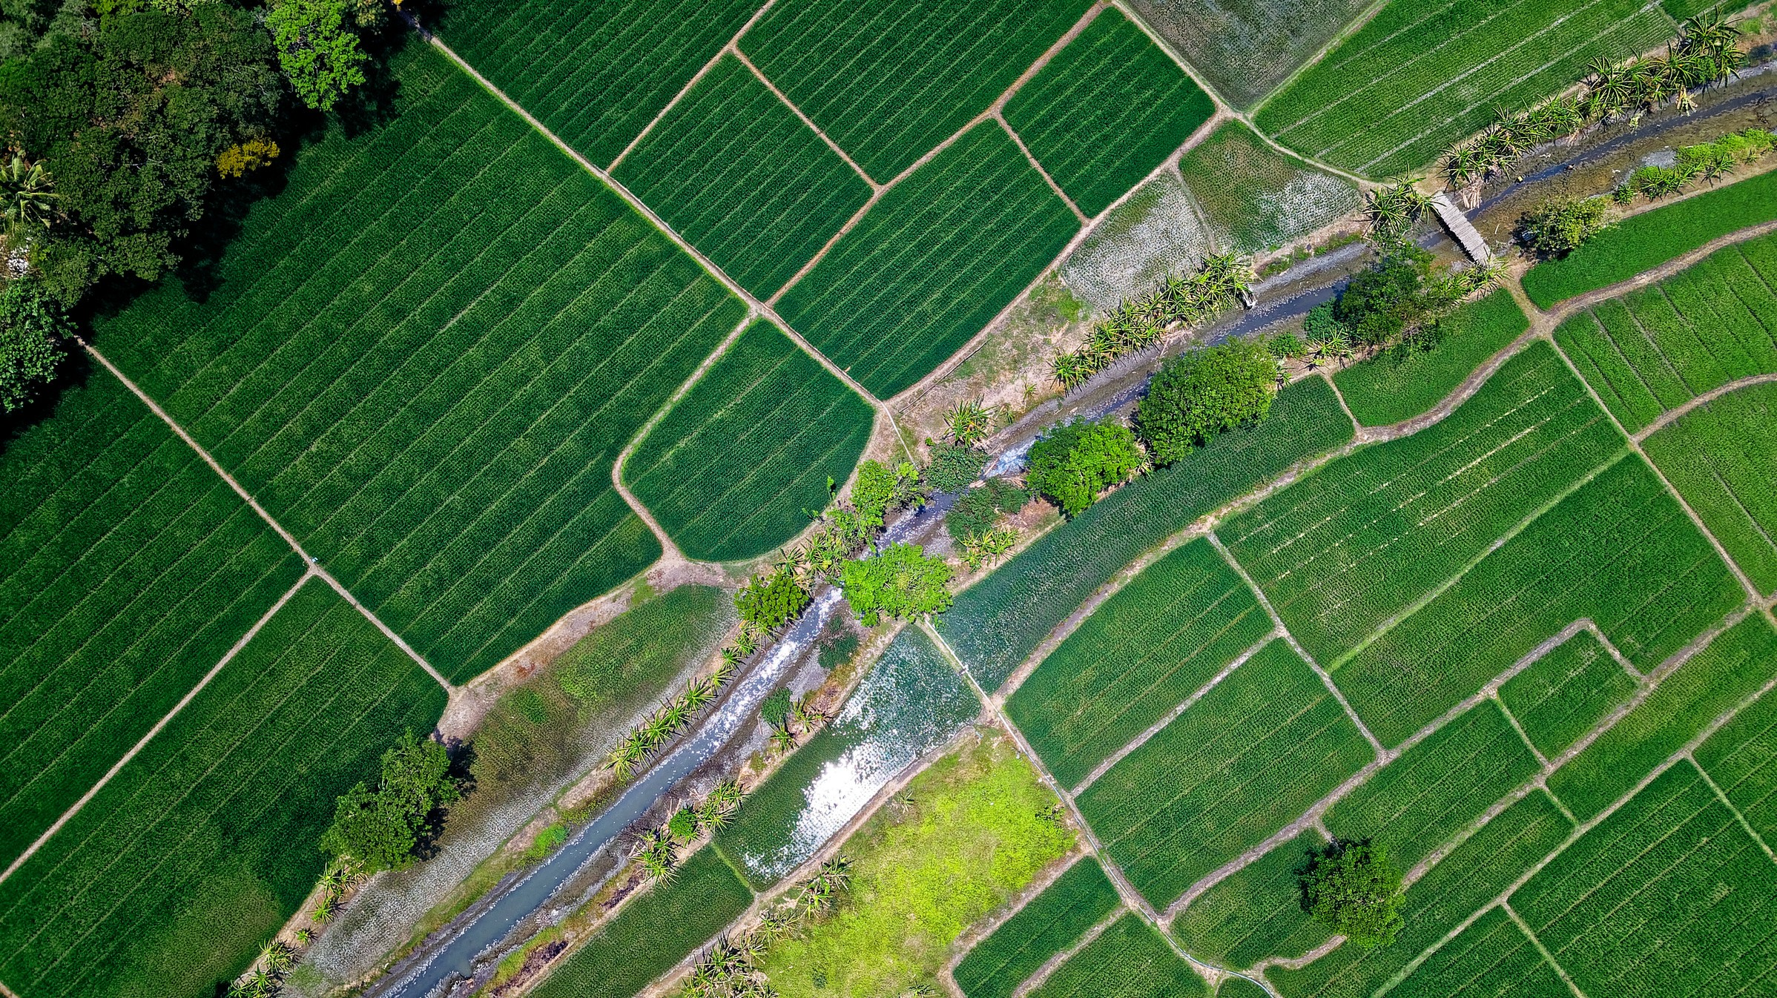
Project
Background

Slide 10
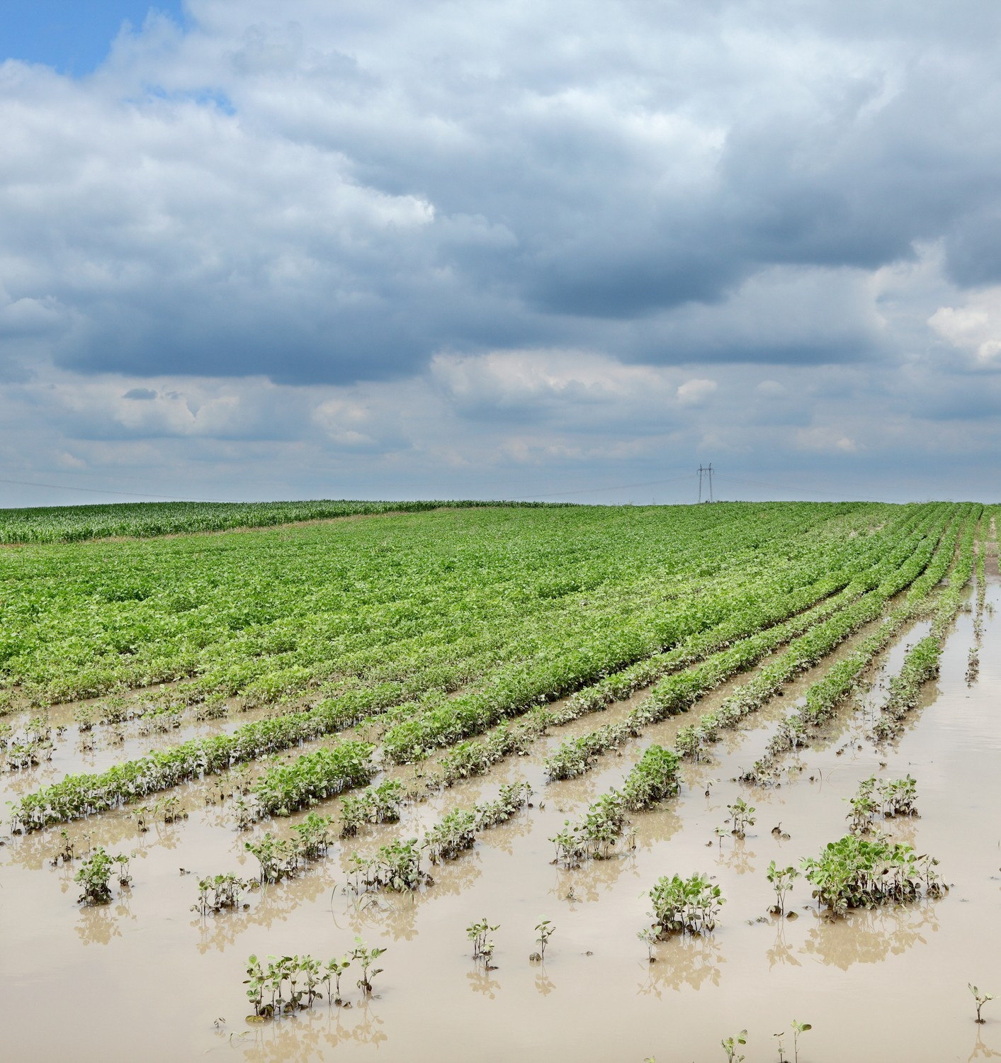
Background
With the of crop production concentrated within California and the Midwest, the constant threat of wildfires, freezes, flooding and tornadic events proves to be a reoccurring risk for agriculture. For example, the weather and climate disasters of 2020 left over $3.6 billion in uncovered crop and rangeland losses.
Projected increases in temperatures, changes in precipitation patterns, changes in extreme weather events, and reductions in water availability may all result in reduced agricultural productivity and subsequently reduced business profitability.
The increases in the frequency and severity of extreme weather events can interrupt crop management and logistics while increasing temperatures can contribute to the spoilage and contamination of crops. This can result in food prices spiking after extreme events and can worsen if they are expected to be more frequent in the future.

Slide 11
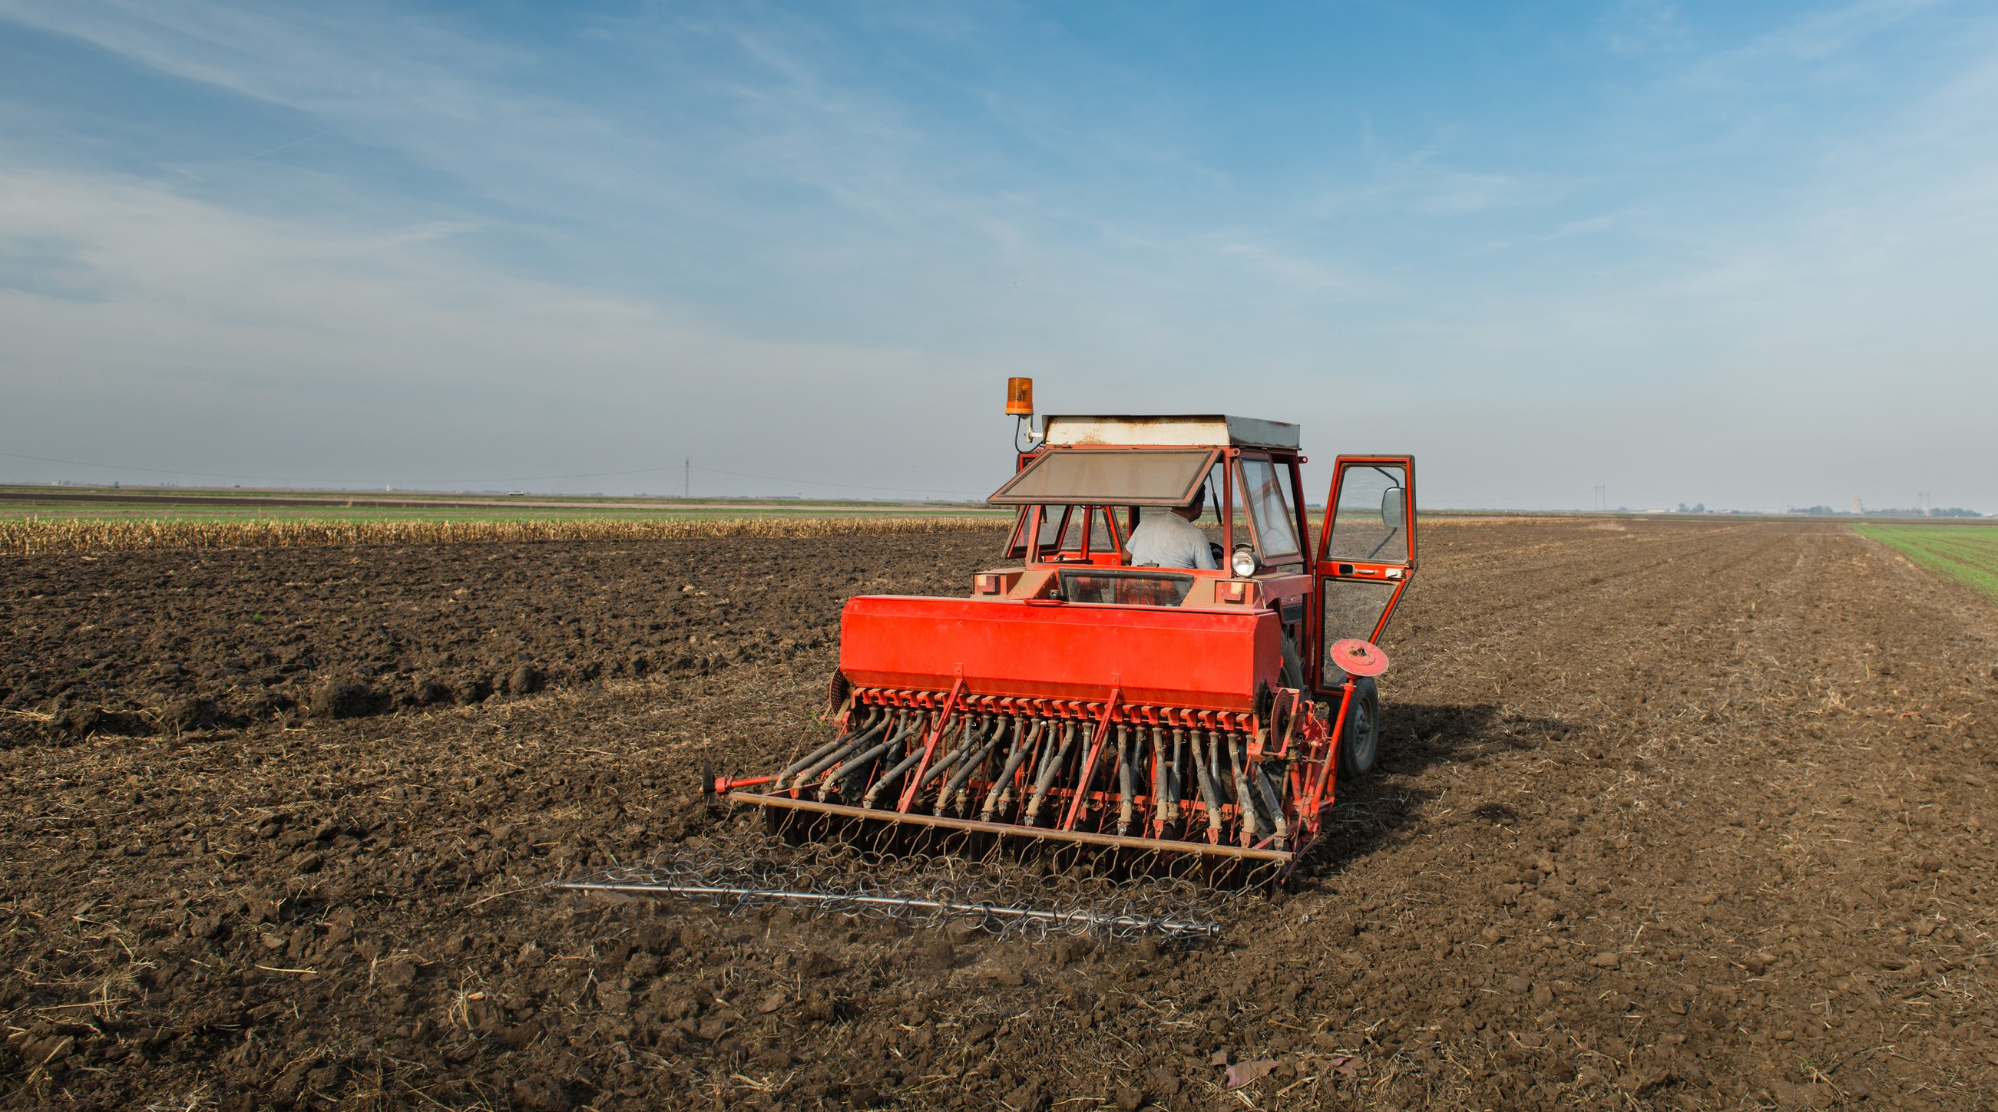
Project
Methodology

Slide 12
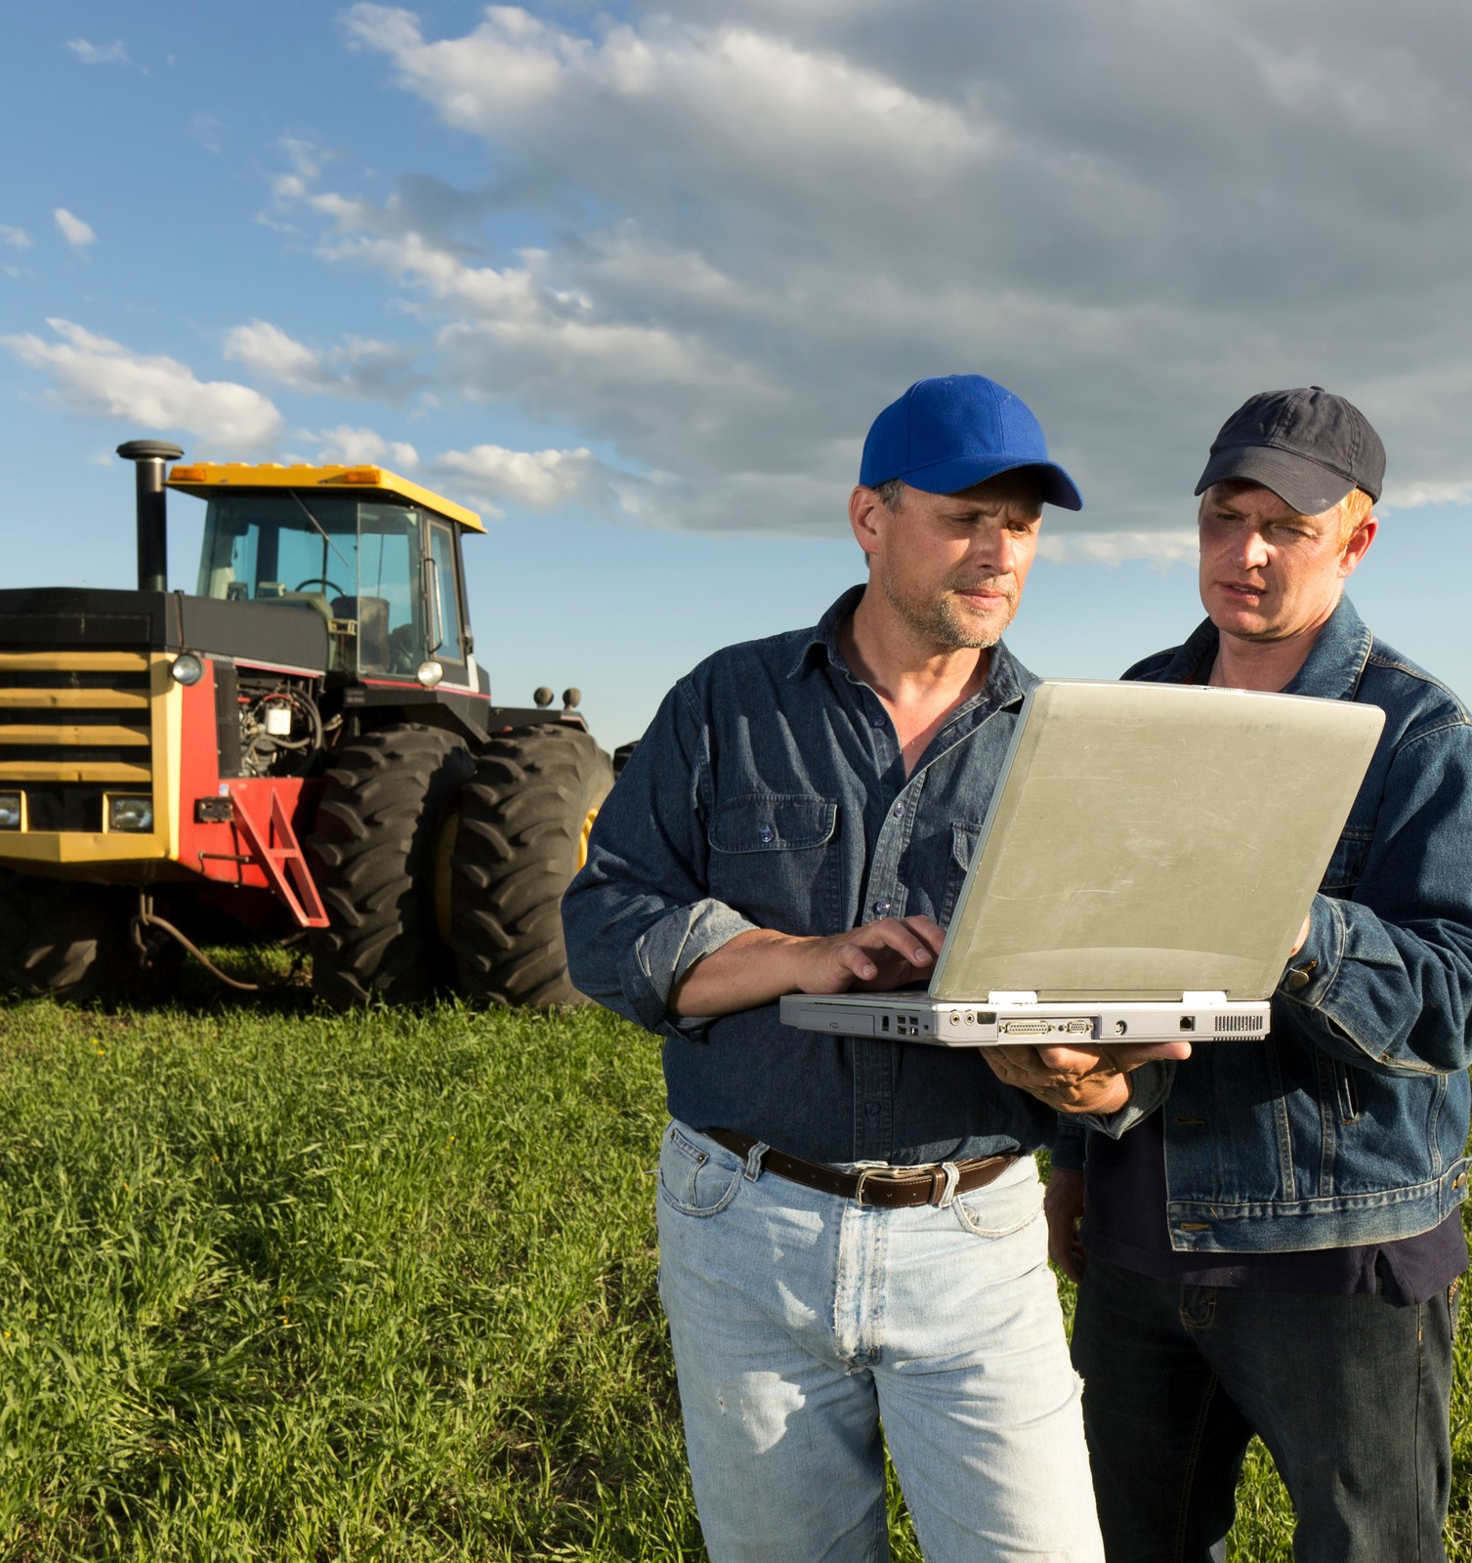
DATA
Retrieved from Food and Agricultural Organization of the United Nations.
https://www.fao.org/faostat/en/#home
Data includes all 50 states in the U.S excluding territories.
Covers timespan of 20 years; 2000-2020
Focused three major crops in the US; Wheat, Soybean, and Maize (corn)
Focused the relationship between Temperature Change, Tonnage, and Crop Value of each crop type

Slide 13
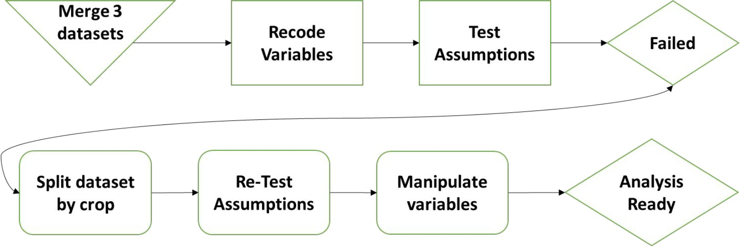
Data Wrangling

Slide 14

Analysis
Sample size of 20 per year for each crop
Used RStudio to complete the data exploration.
Used Jupyter Lab/Python to run simple linear regressions on each crop (Wheat, Soybean, and Maize/Corn) variable against Temperature change.
Jupyter Lab/Python was also used to run the correlation matrix of the dataset.
Created visuals in Tableau to explore the relationship between the variables.

Slide 15
NetCDF
What is NetCDF?
NetCDF is a set of software libraries and self- describing, machine-independent data formats that support the creation, access, and sharing of array-oriented scientific data.
Who created it?
NetCDF was developed and is maintained at Unidata. Unidata provides data and software tools for use in geoscience education and research. Unidata is part of the University Corporation for Atmospheric Research (UCAR) Community Programs (UCP). Unidata is funded primarily by the National Science Foundation.
Where can it be found?
The NetCDF homepage may be found at http://www.unidata.ucar.edu/software/netcdf/. The NetCDF source-code is hosted at GitHub, and may be found directly at http://github.com/Unidata/netcdf-c

Slide 16
Accessing NetCDF Files
Python Script
Examples of code are at:
https://confluence.ecmwf.int/display/CKB/How+to+convert+ NetCDF+to+CSV
Download from NASA website. Must have Java 9 to use.
https://www.giss.nasa.gov/tools/panoply/download
Panoply
Instructions can be found:
netcdf4excel
https://confluence.ecmwf.int/display/CKB/How+to+convert+ NetCDF+to+CSV

Slide 17
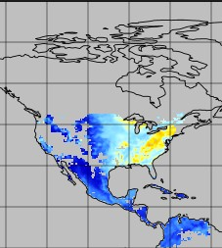
NetCDF Resources
Really good video that explains NetCDF files and shows examples of how to visualize the data
https://www.youtube.com/watch?v=XqoetylQAIY
Interesting basic understanding of how a NetCDF works https://www.youtube.com/watch?v=UvNBnjiTXa0
An hour plus long video that shows some Jupyter Notebook examples with code, NetCDF Why and How: Creating Publication Quality NetCDF Datasets
https://www.youtube.com/watch?v=7YYTXa4qyfo
For R:
https://cirrus.ucsd.edu/~pierce/ncdf/
https://www.r-bloggers.com/2016/08/a-netcdf-4-in-r- cheatsheet/
NetCDF4 info:
https://unidata.github.io/netcdf4-python/#reading-data- from-a-multi-file-netcdf-dataset https://www.guillaumedueymes.com/courses/tutorial_pyt hon_netcdf/3-cartopy_library/

Slide 18
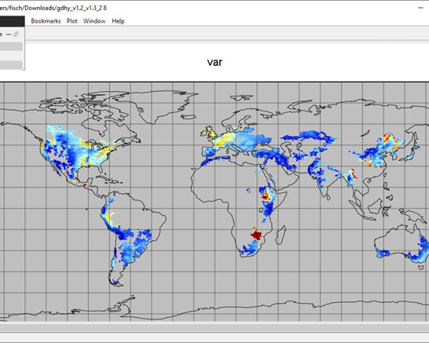
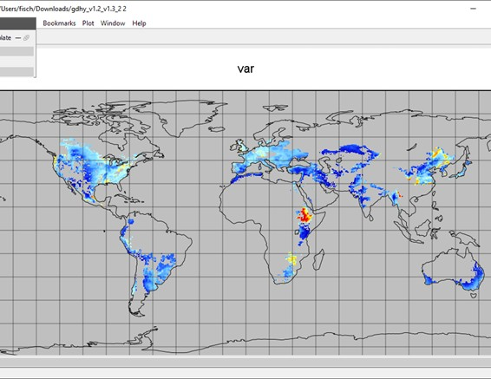
Panoply Examples - Wheat
1999
2016

Slide 19
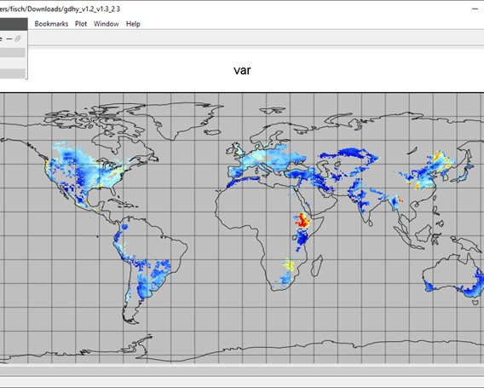
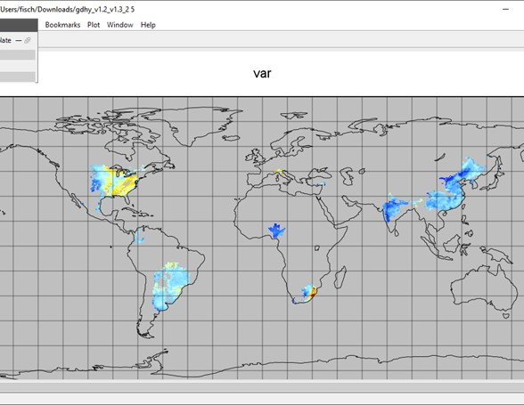
Panoply Examples - Soybean
1999
2016

Slide 20
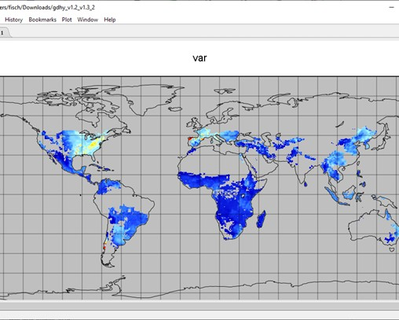
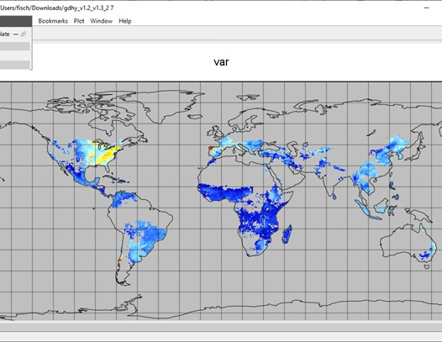
Panoply Examples - Maize/Corn
1999
2016

Slide 21
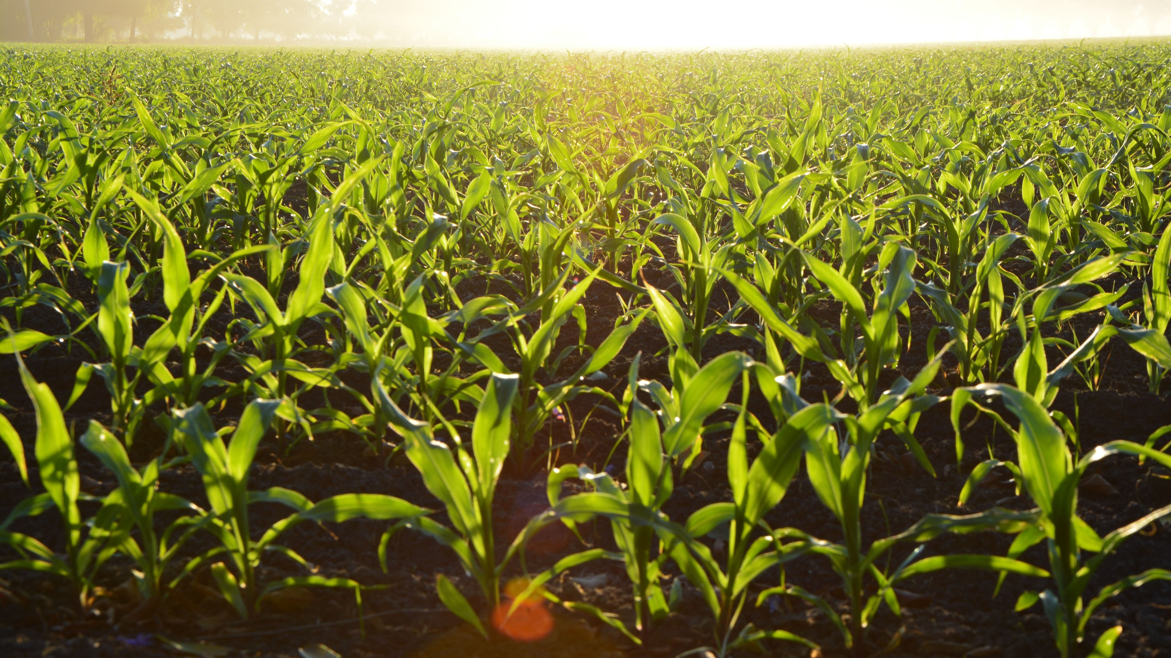
Project
Results

Slide 22
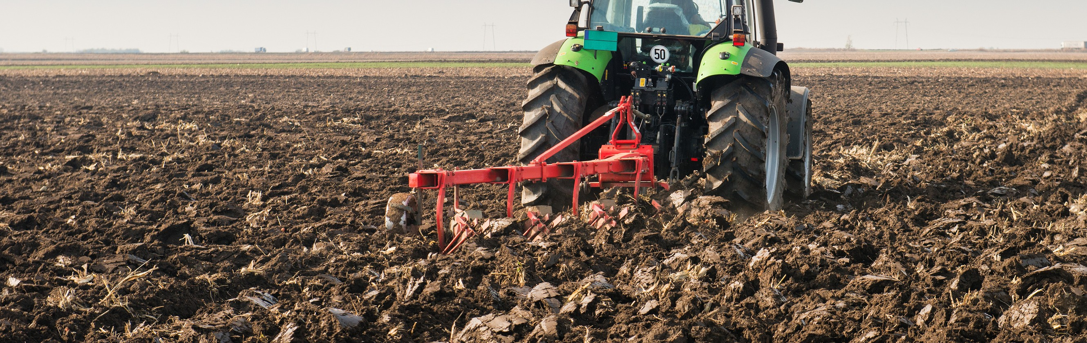
Evaluation Question #1
What effect does climate change have on crop production in the United States?

Slide 23
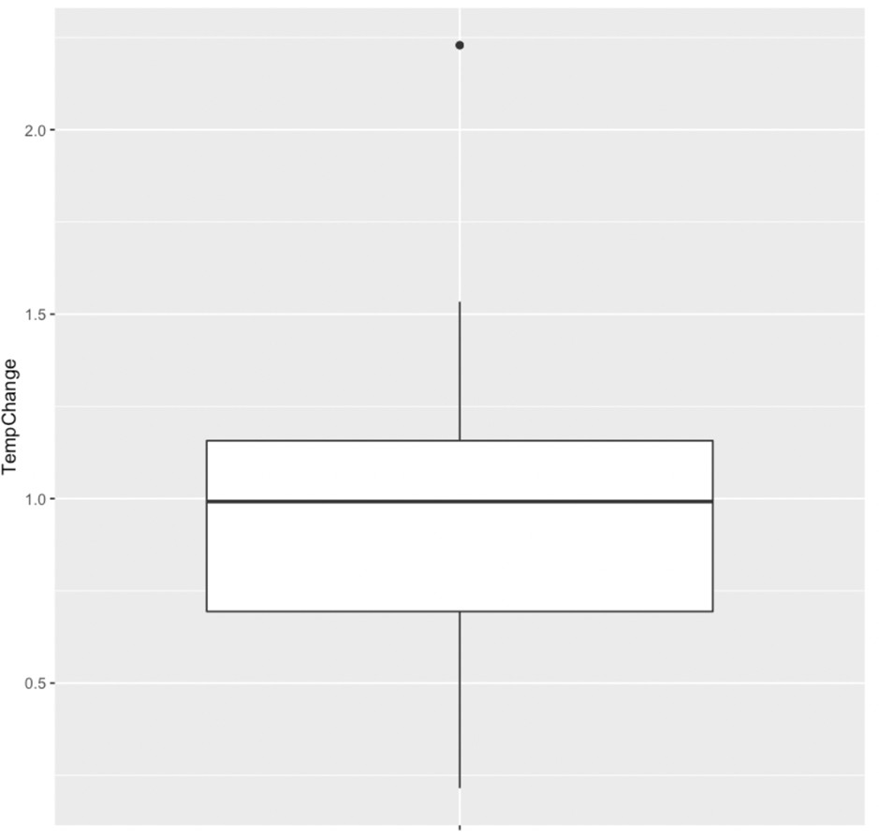
What effect does climate change have on crop production in the United States?
Approximately 75% of crops experienced a temperature change of 1 degree Celsius.
Most crops temperature change is 2 degrees Celsius.

Slide 24
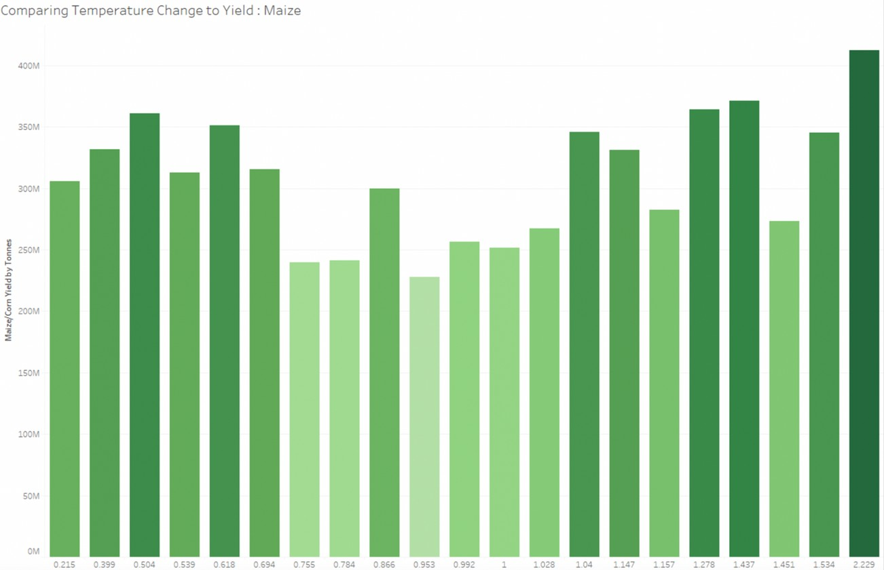
Temperature Change to Maize/Corn Yield
Higher temperature change in degree celsius means higher production.

Slide 25
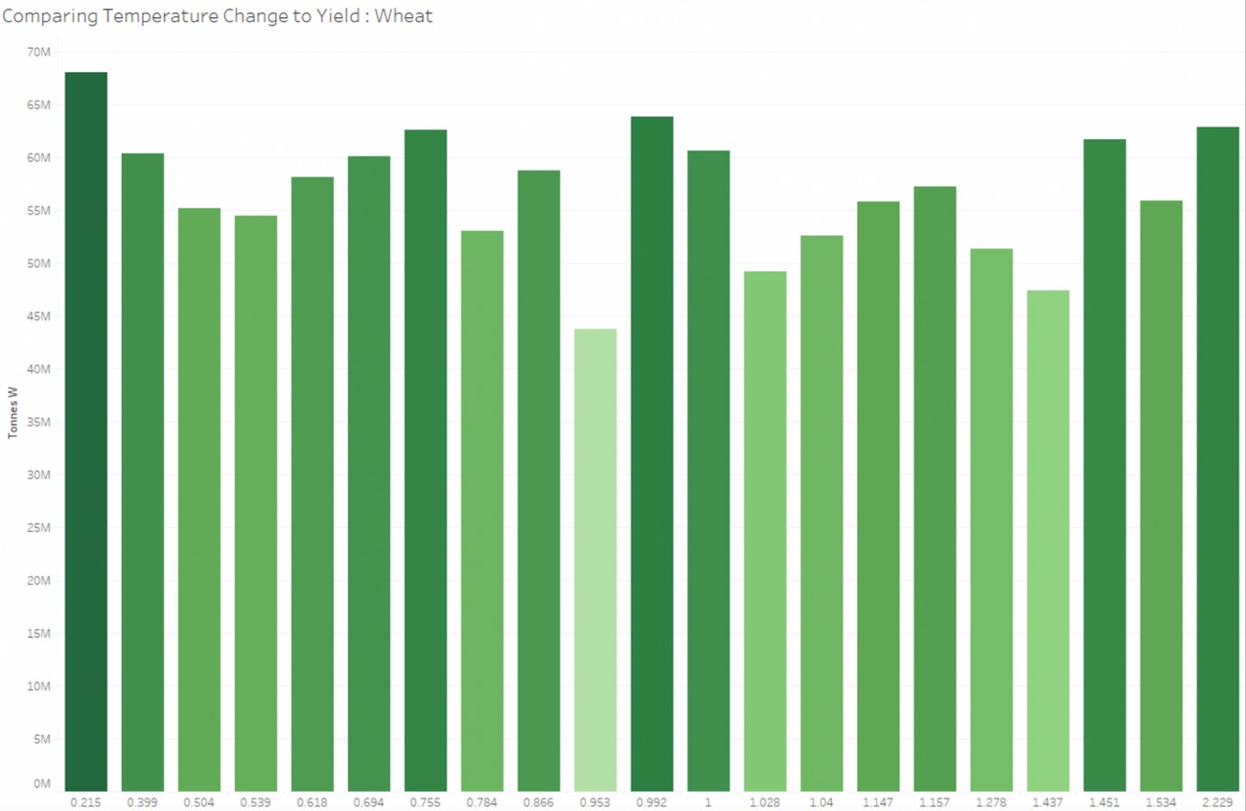
Temperature Change to Wheat Yield
Lower temperature change in degree Celsius means higher production.

Slide 26
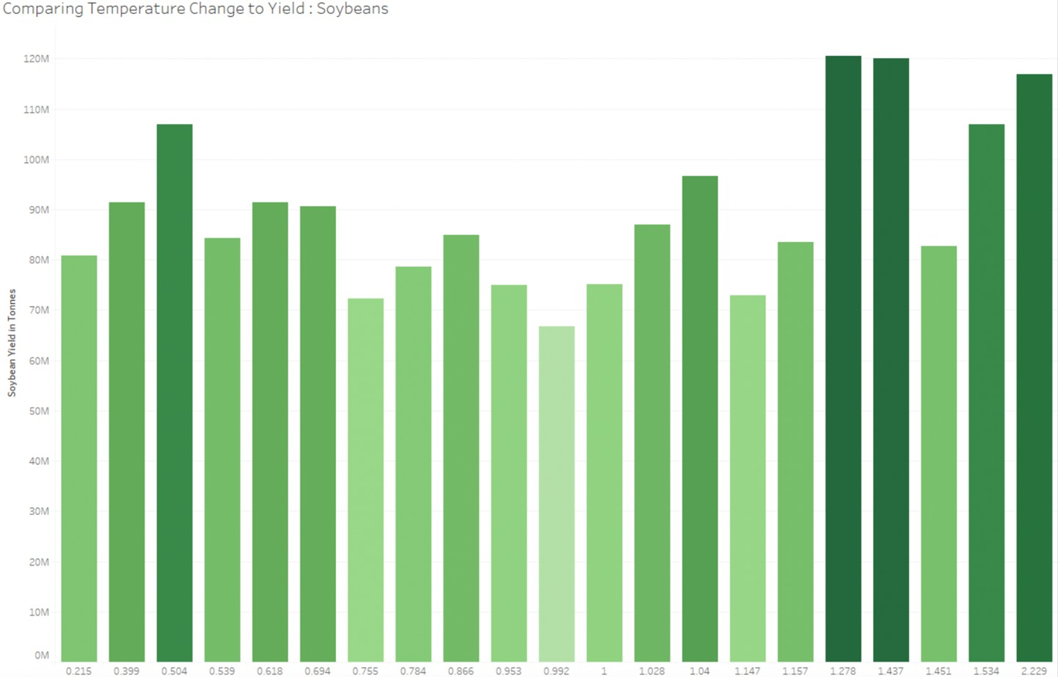
Temperature Change to Soybean Yield
Temperature change between
1.278 and 1.437 degrees Celsius means higher production.

Slide 27
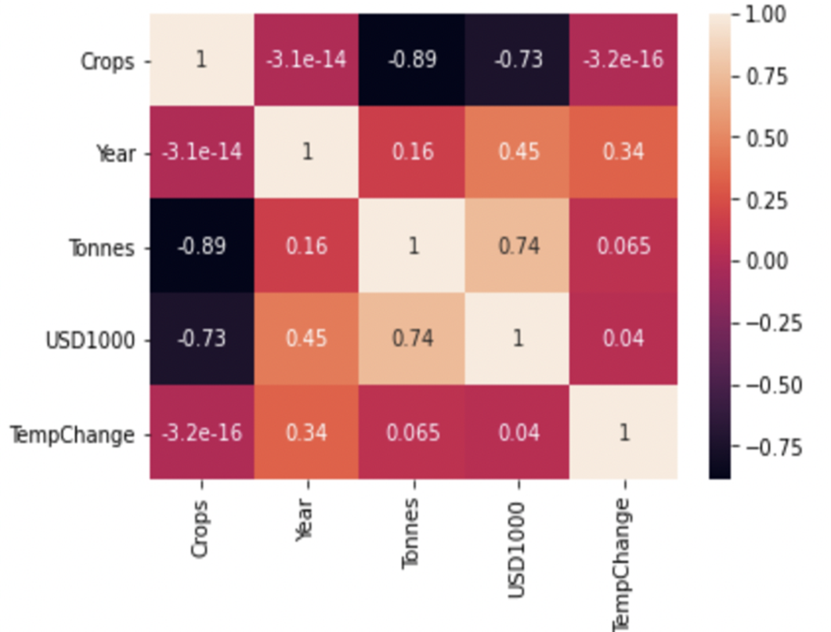
Correlation Chart
Year and TempChange 34%
Year and USD1000 45%
Year and Tonnes 16%
Tonnes and TempChange 6.5%
Tonnes and USD1000 74%

Slide 28
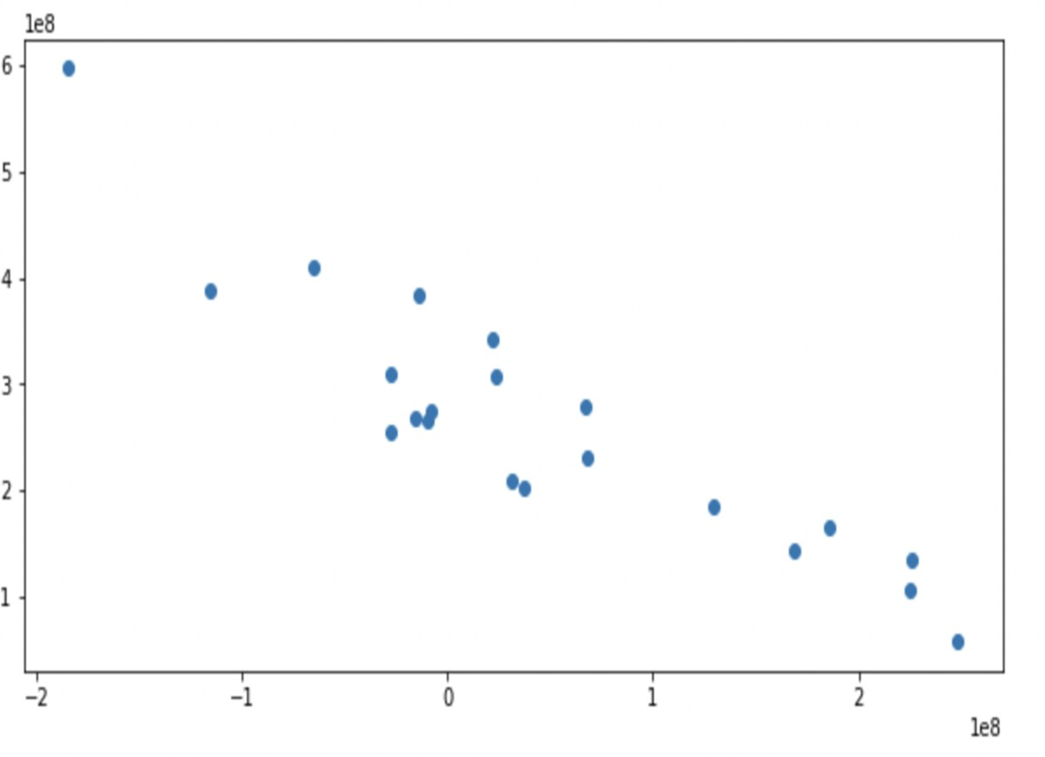

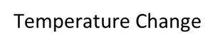
Temperature Change versus Tonnes Maize
Year and TempChange 34%
Year and USD1000 45%
Year and Tonnes 16%
Tonnes and TempChange 6.5%
Tonnes and USD1000 74%

Slide 29
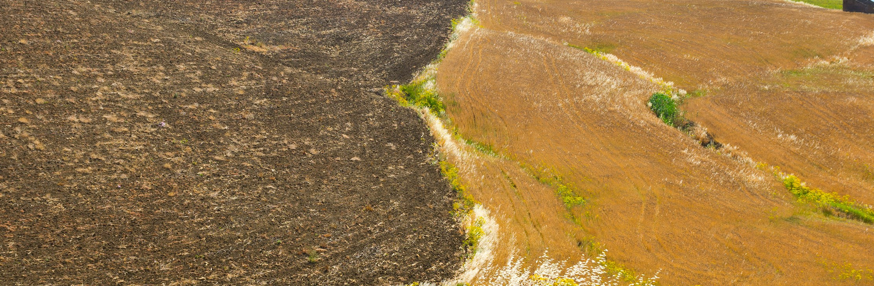
Evaluation Question #2
How will the crop production change over time?

Slide 30
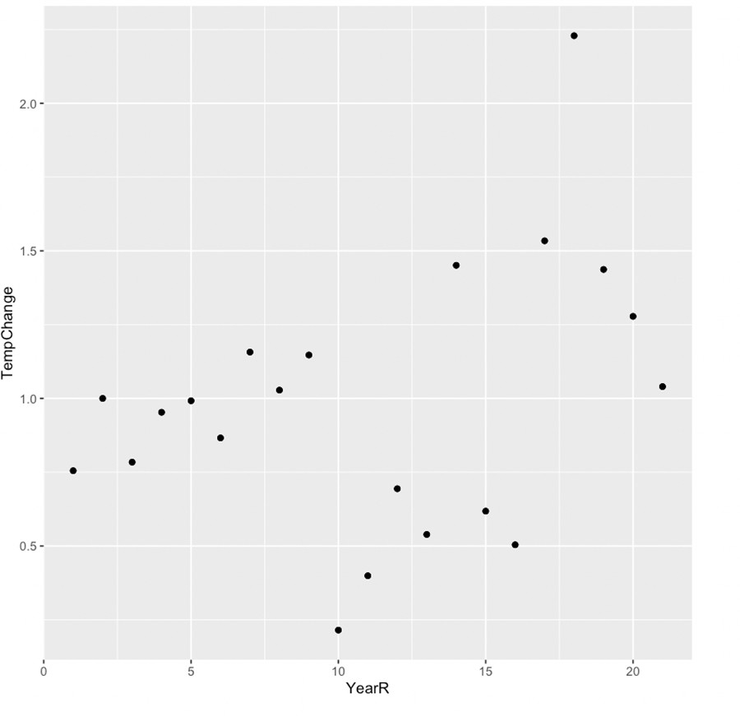
Correlation Analysis
Drastic temperature change in between the year 15 and 20
(2014-2019).

Slide 31
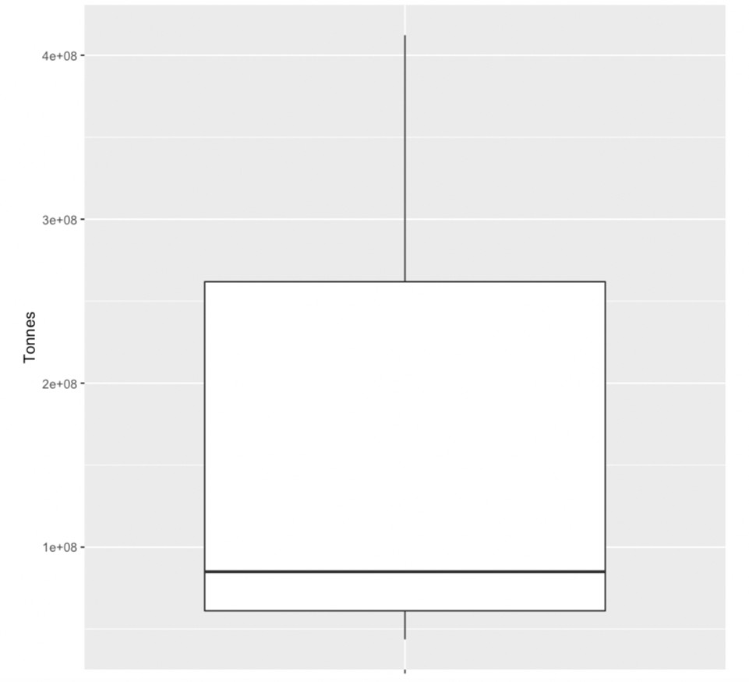
Quantitative Analysis
Approximately 75% produced at most 300,000,000 crops.

Slide 32
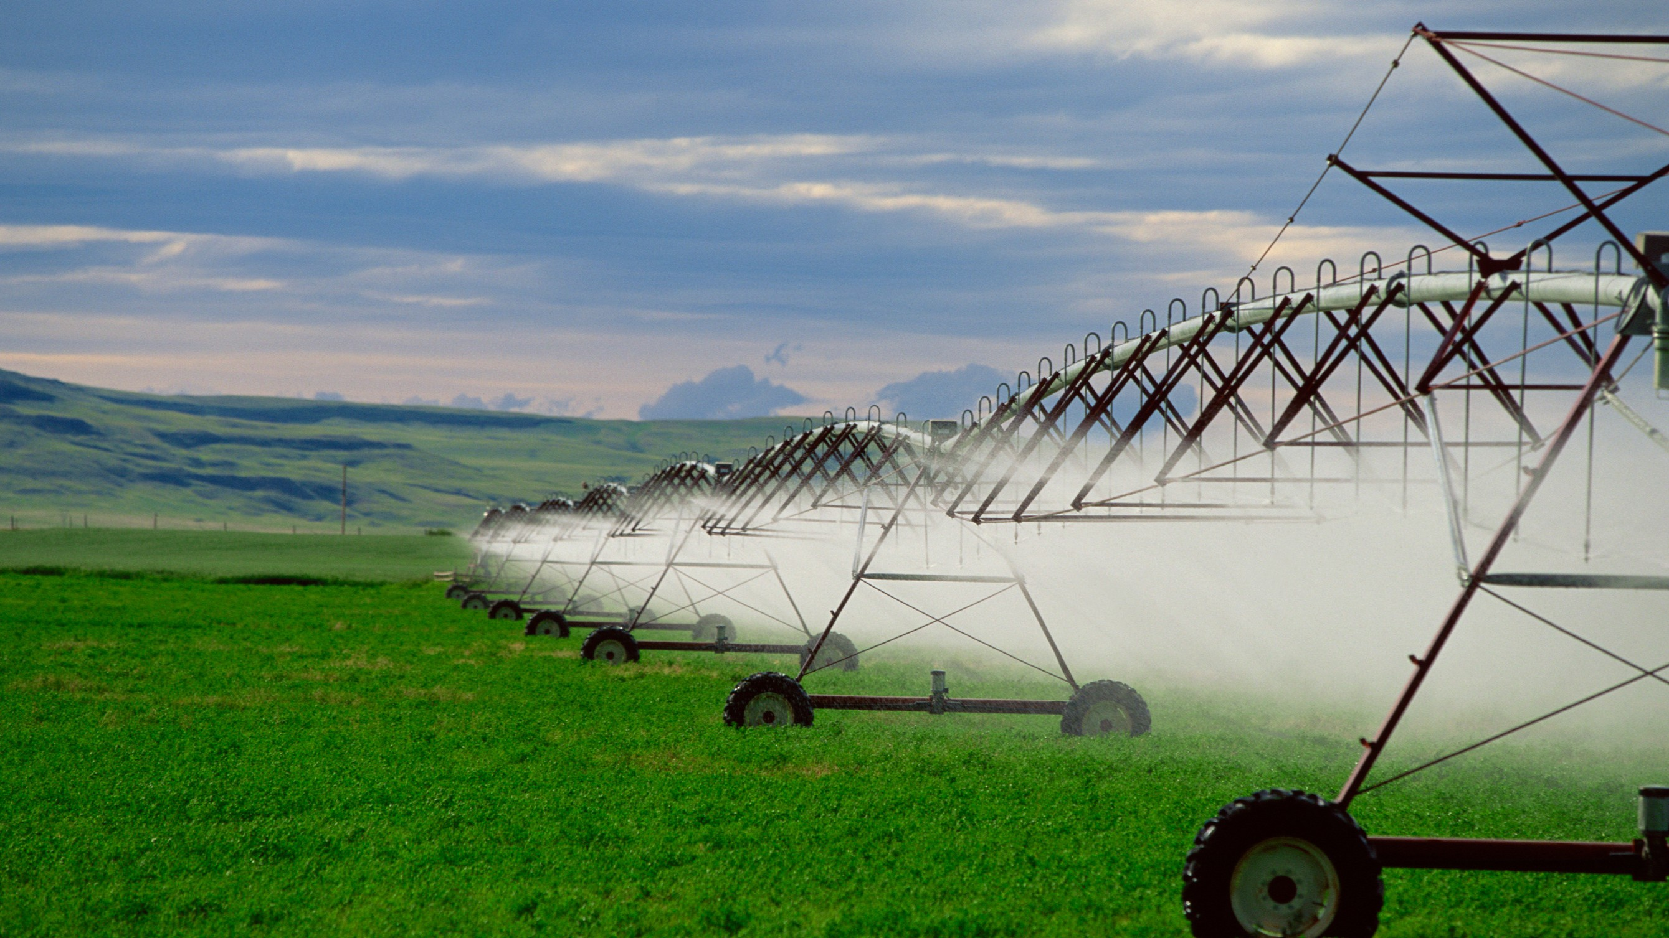
Project
Summary

Slide 33
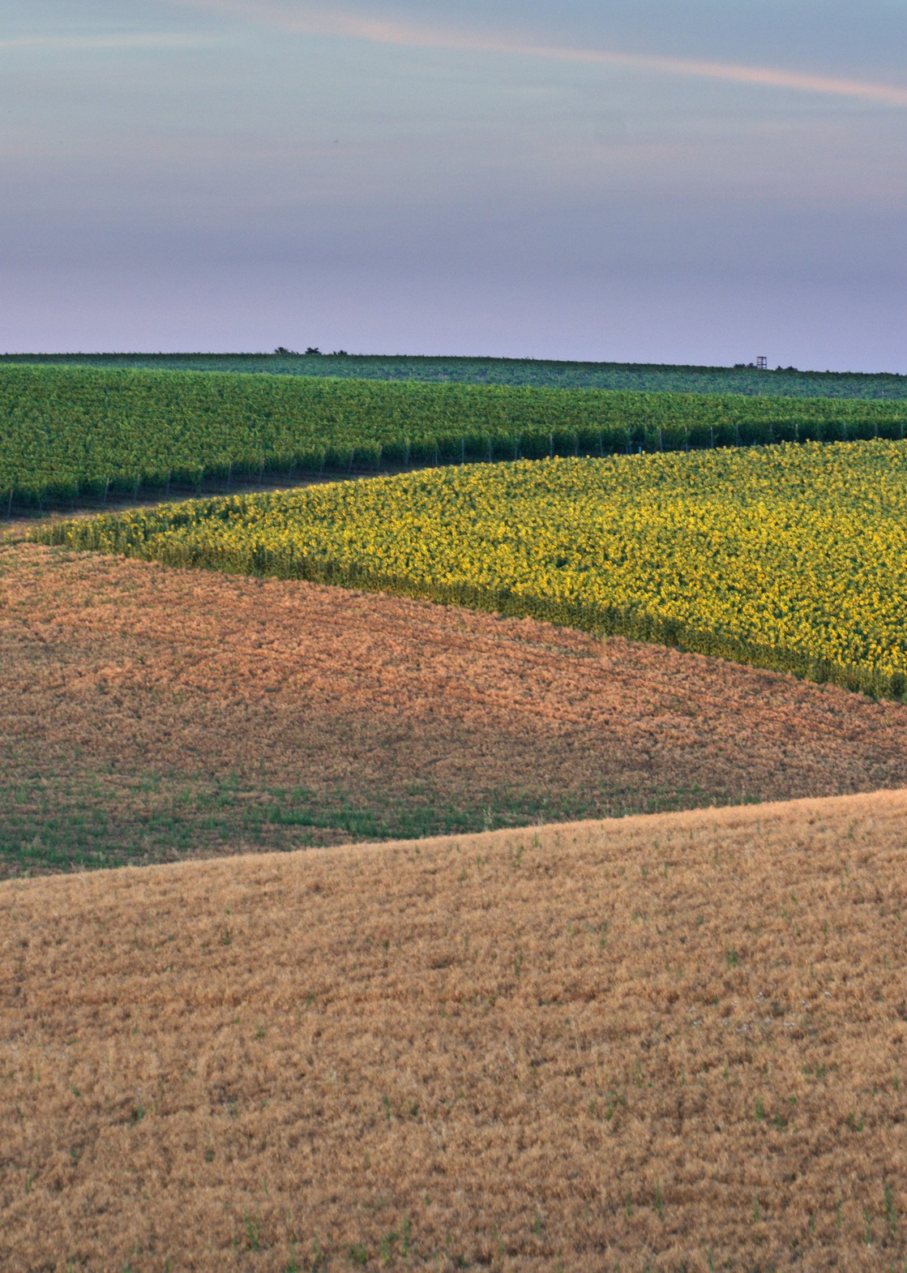
Summary
What effect does climate change have on crop production in the United States?
Temperature change had both positive and negative effect on the different crops production and value.
The Maize and Soybeans production and value increased as the temperature increased.
Wheat production and value decreased as the temperature increased.
The effect was inconclusive because of the following reasons.
Different temperature range for growth for each crop. Shifts in areas of crop production.
Planting times change to longer growing seasons. Crop rotations and water management
Seed genetic selection; example drought-tolerant varieties and fertilizer management
How will the crop production change over time?
In the short-term farmers will continue to adapt to climate changes therefore little effect on the production and value of the crops.
In the longer term the existing adaptive measures will likely not be sufficient to buffer the impacts of climate change without significant impacts to crop production.

Slide 34
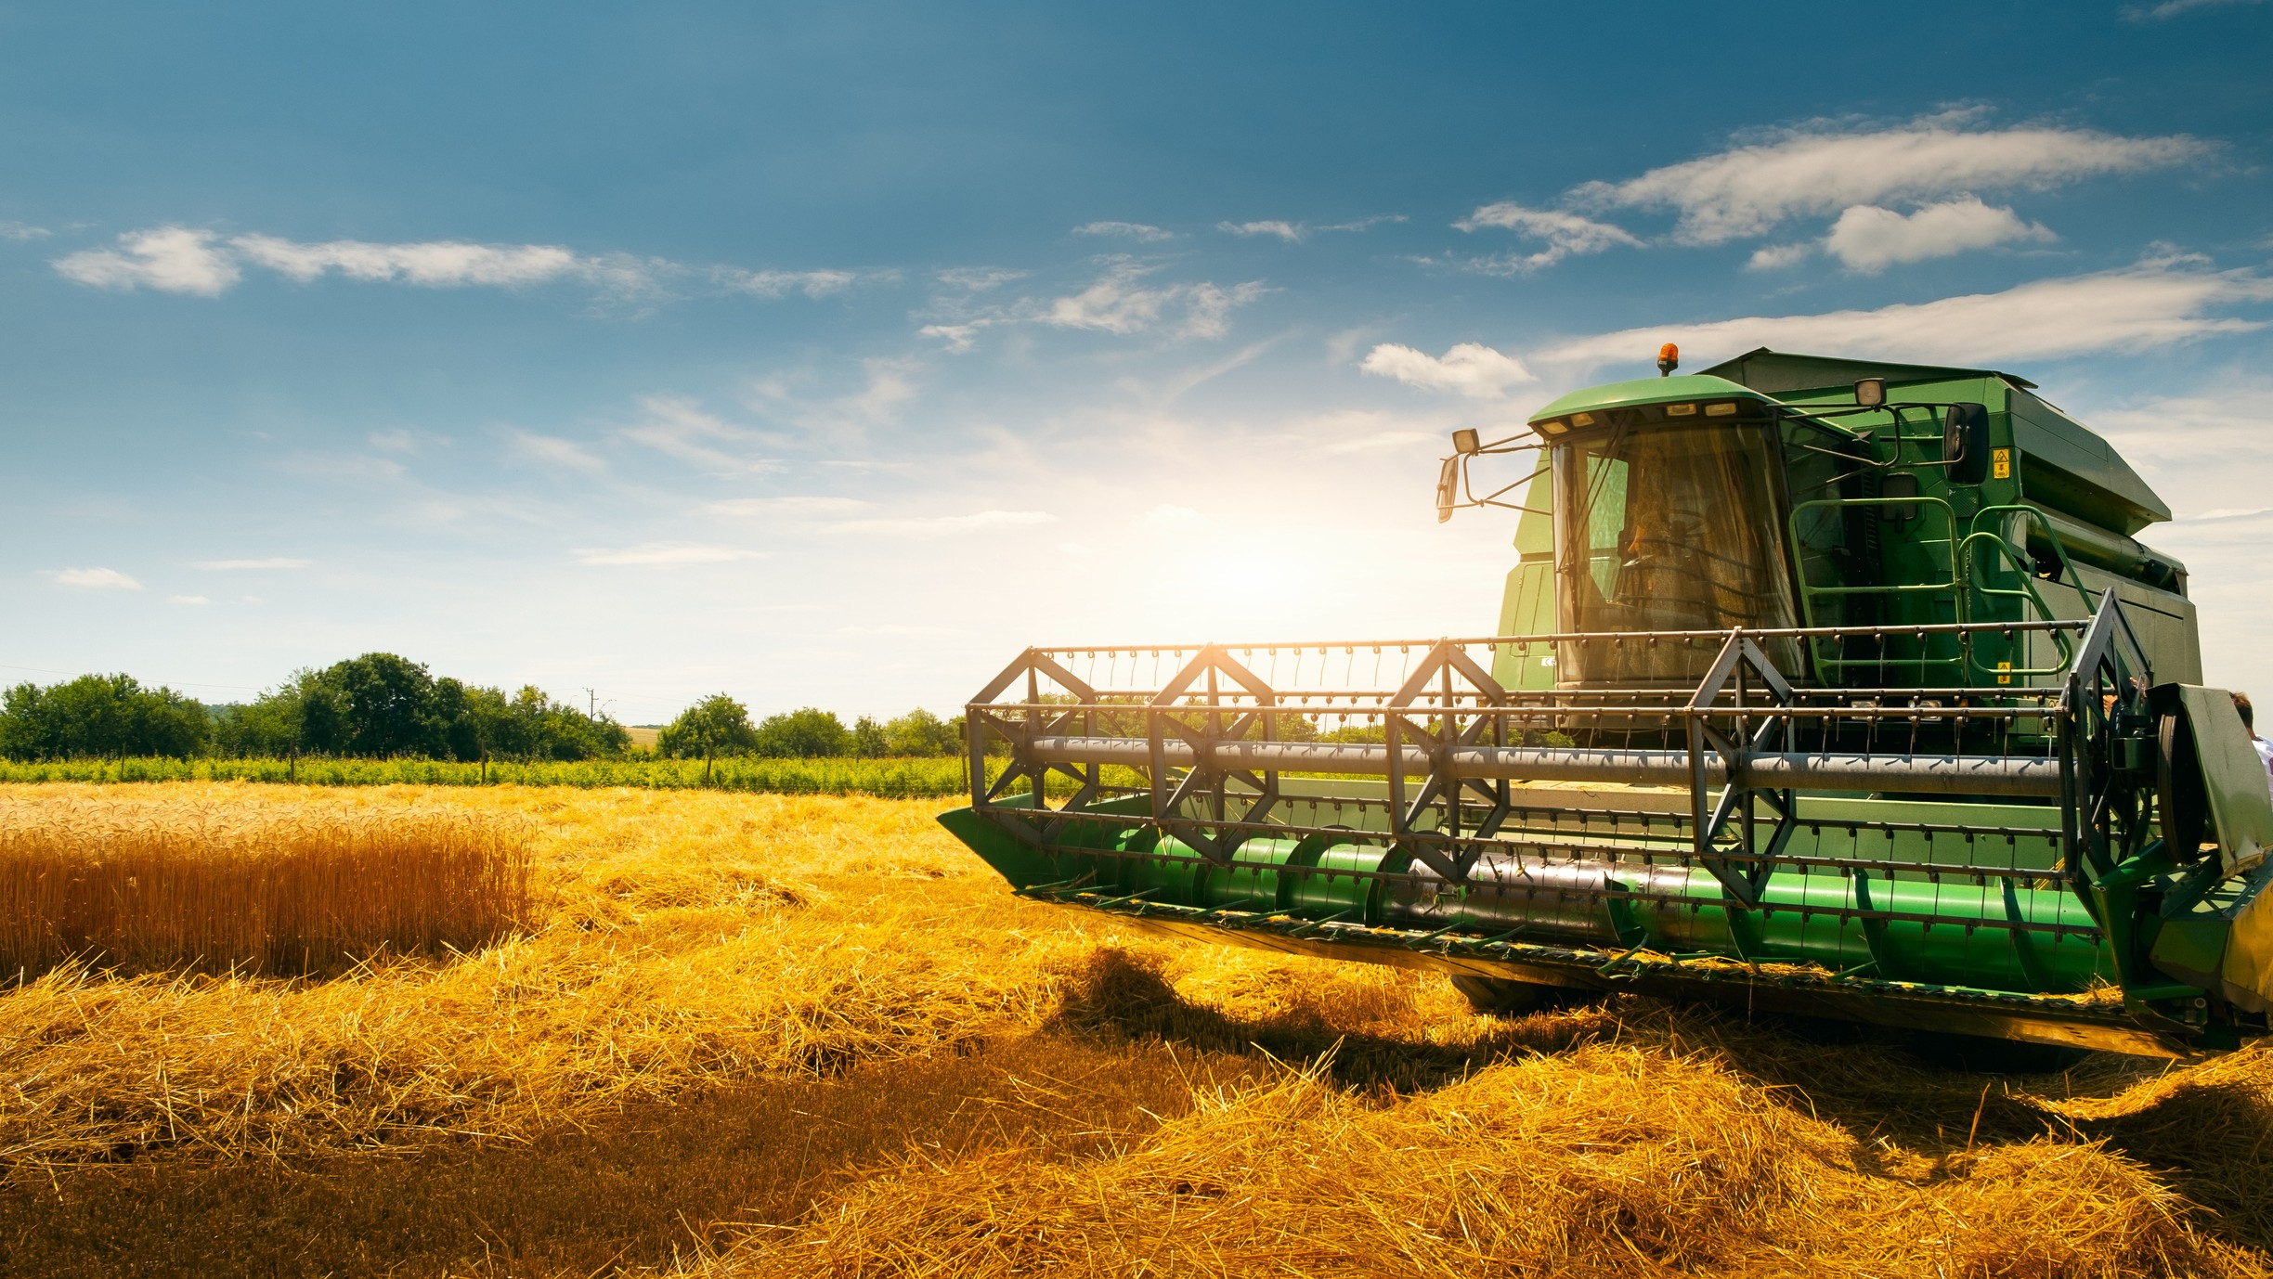
Project
Conclusion

Slide 35
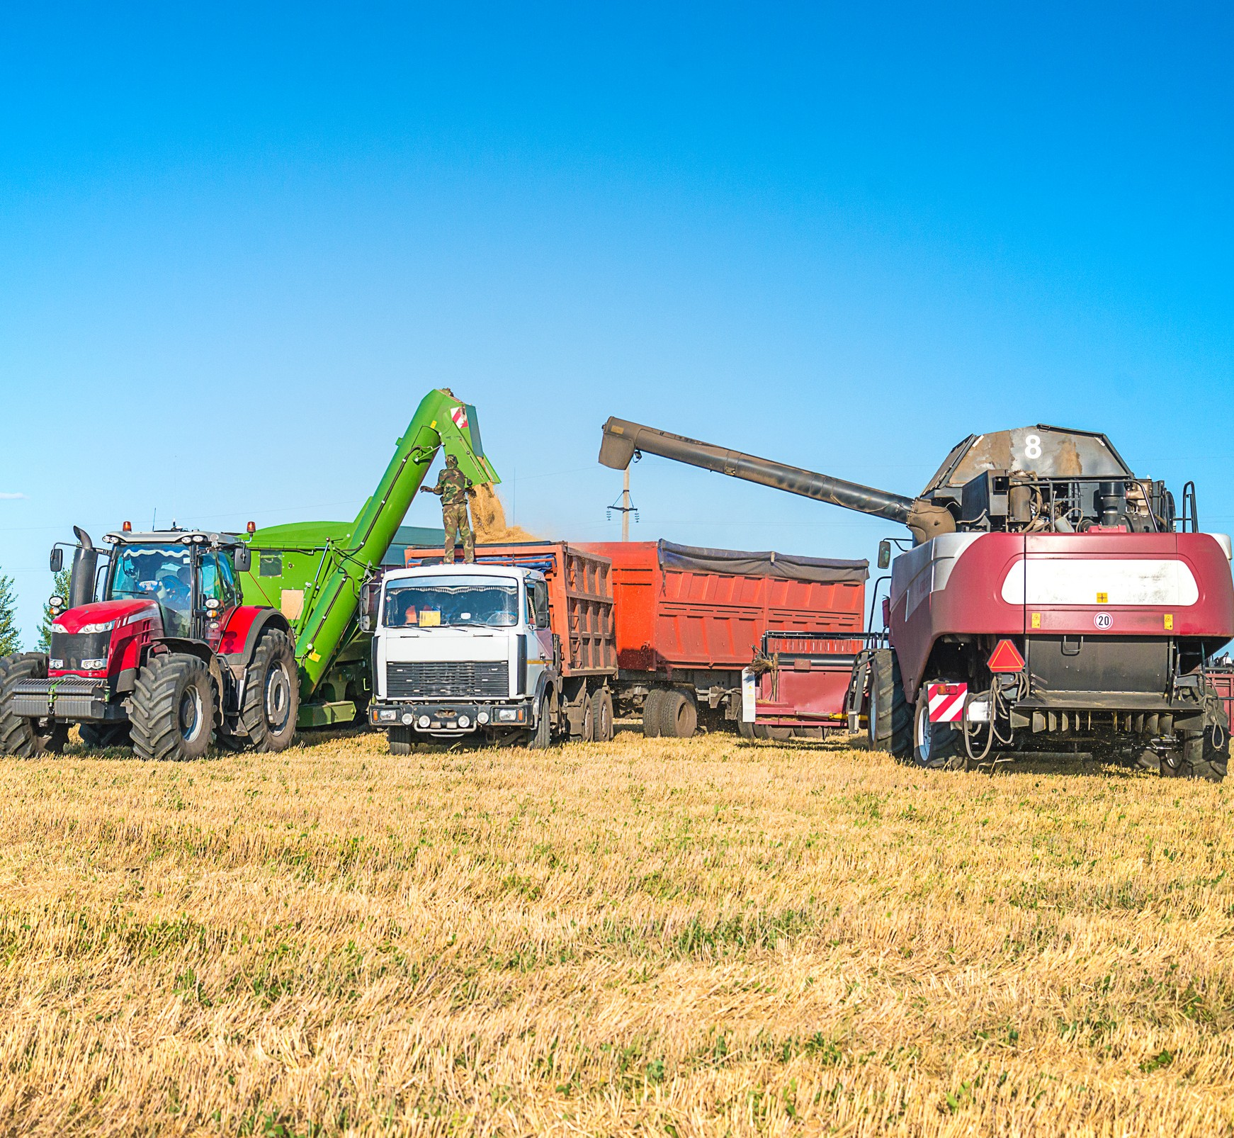
Conclusion
This research has the potential to:
Assist further research on crop resiliency in regards to temperature change.
Give farmers data that would help them in their crop rotation or substitution decisions.
Help mitigate future risk.
Help policy makers develop effective adaptation planning and assessment strategies.
Future research that includes other aspects of climate change would provide a clearer picture on its full impact on crop production.

Slide 36
QUESTIONS?

